Slide 1
CSET301 – AI-ML
Lecture 30 : Attention model & Transformer

Slide 2

Attention is, to some extent, motivated by how we pay visual attention to different regions of an image or correlate words in one sentence.
Human visual attention allows us to focus on a certain region with “high resolution” (i.e. look at the pointy ear in the yellow box) while perceiving the surrounding image in “low resolution” (i.e. now how about the snowy background and the outfit?), and then adjust the focal point or do the inference accordingly. Given a small patch of an image, pixels in the rest provide clues what should be displayed there. We expect to see a pointy ear in the yellow box because we have seen a dog’s nose.

Slide 3
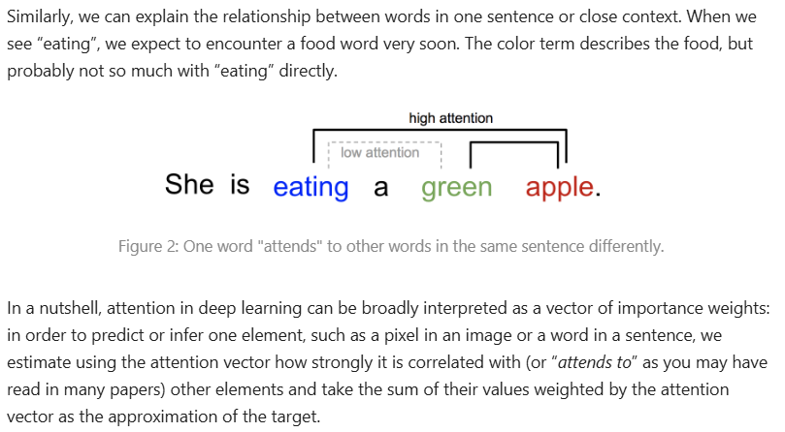

Slide 4
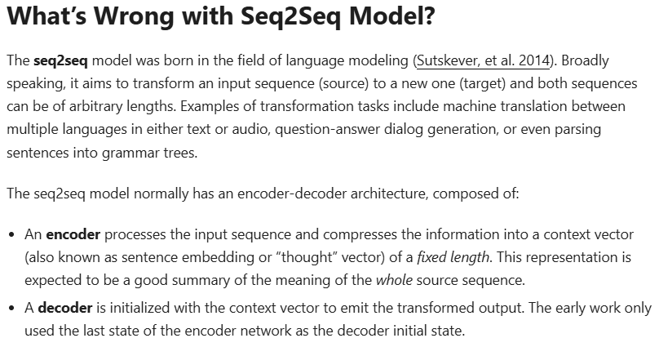

Slide 5
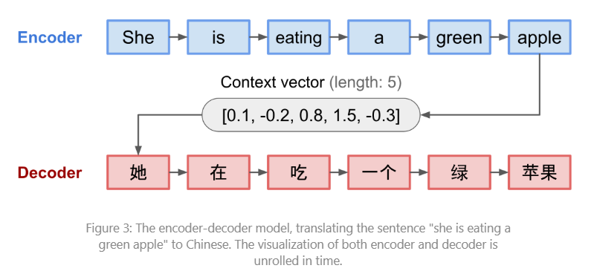
Example of Seq2Seq model

Slide 6
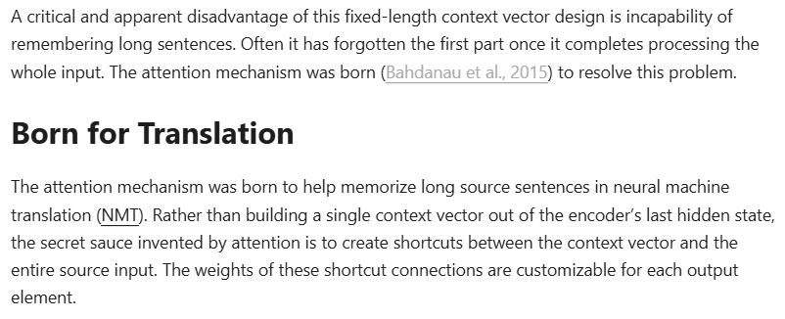

Slide 7
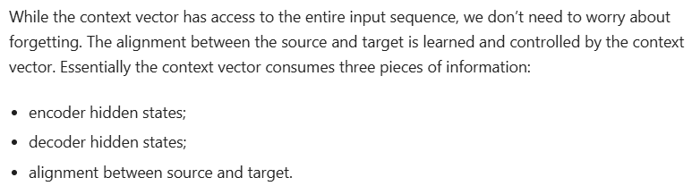

Slide 8
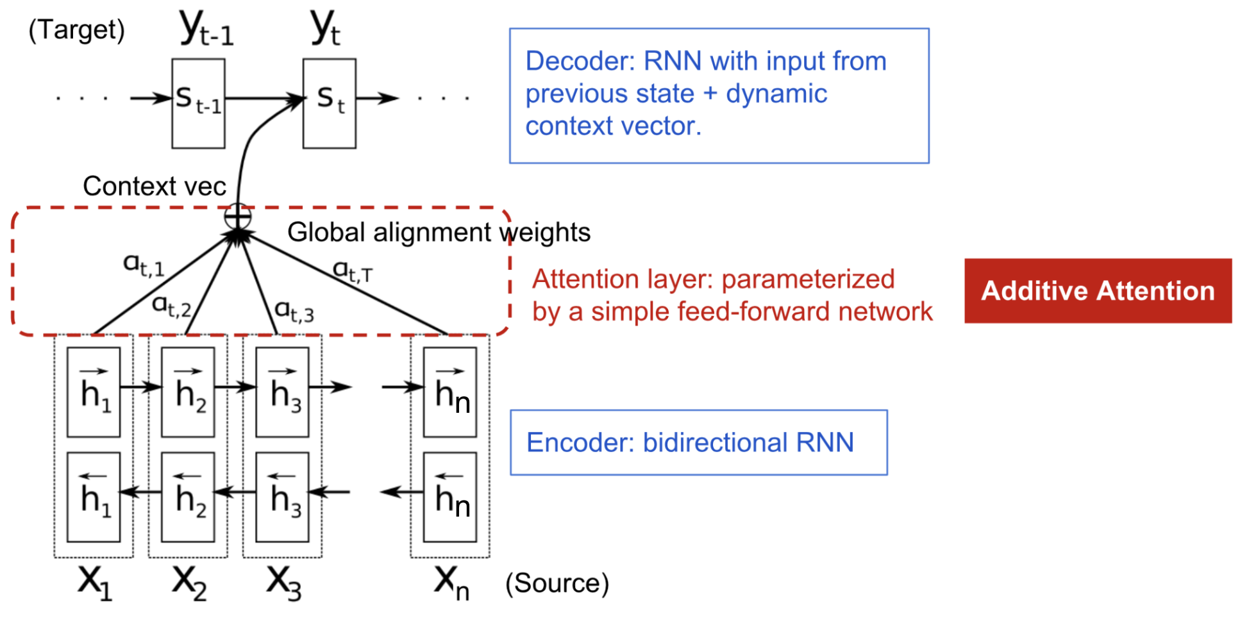


Slide 9
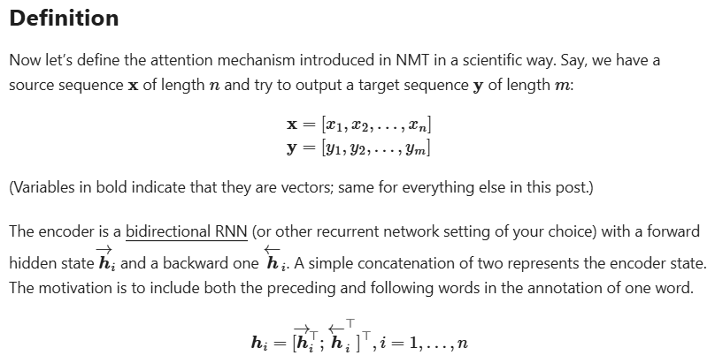

Slide 10
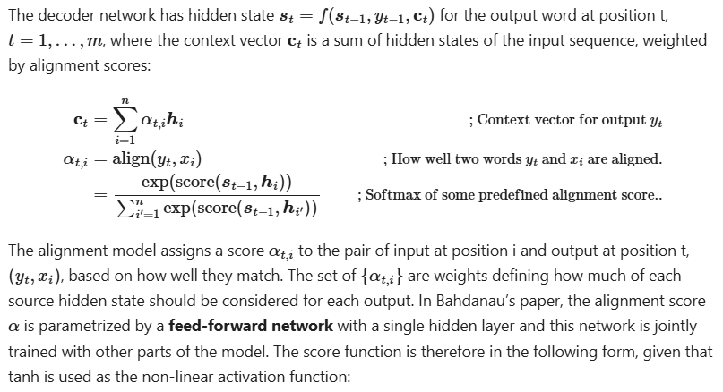

Slide 11
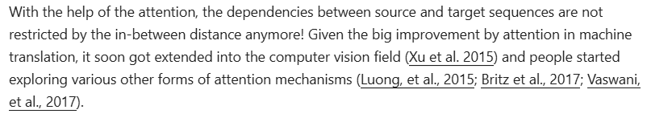

Slide 12
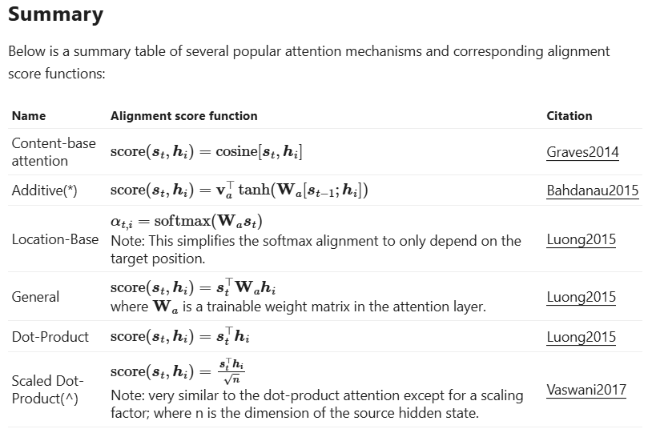

Slide 13
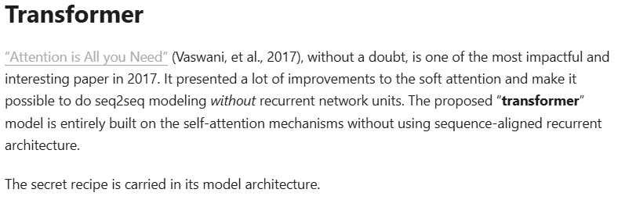

Slide 14
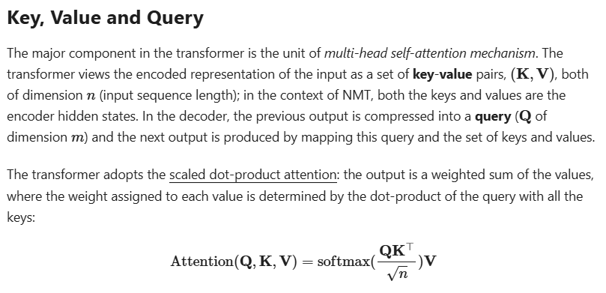

Slide 15
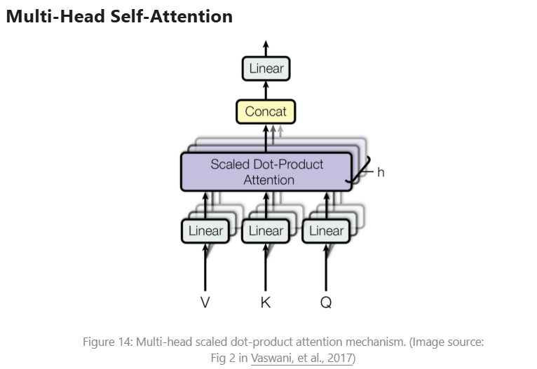

Slide 16
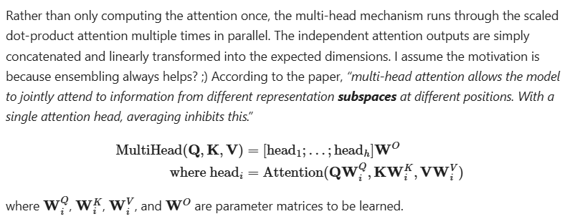

Slide 17
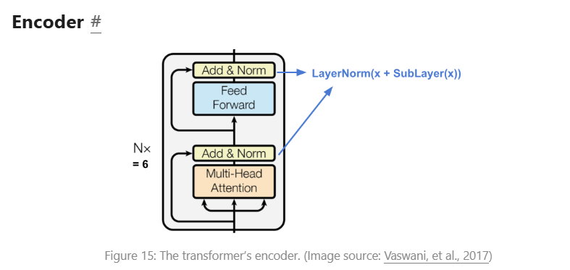
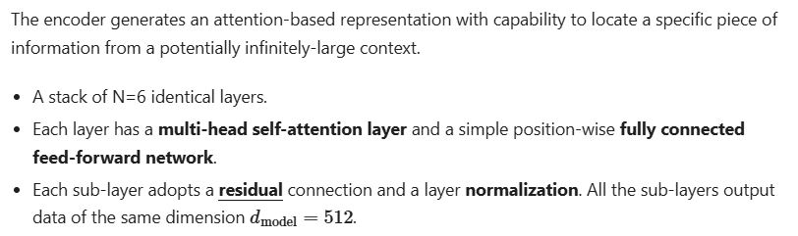

Slide 18
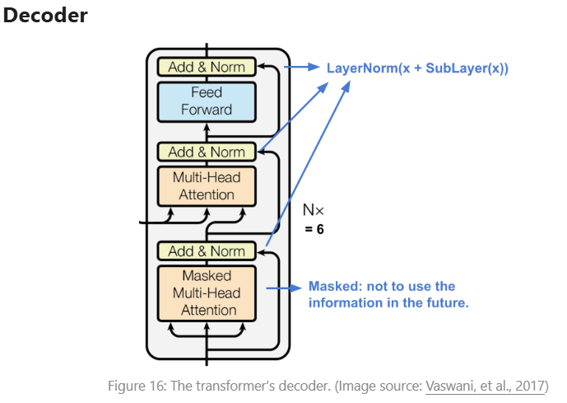

Slide 19
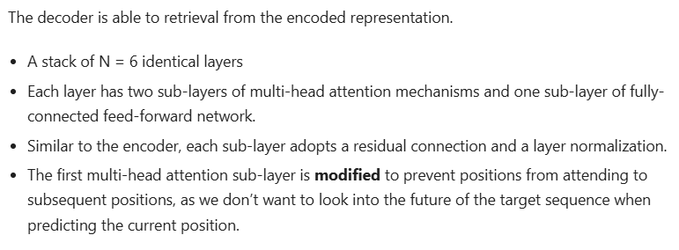

Slide 20
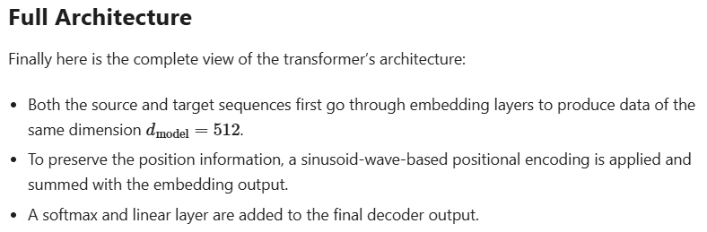

Slide 21
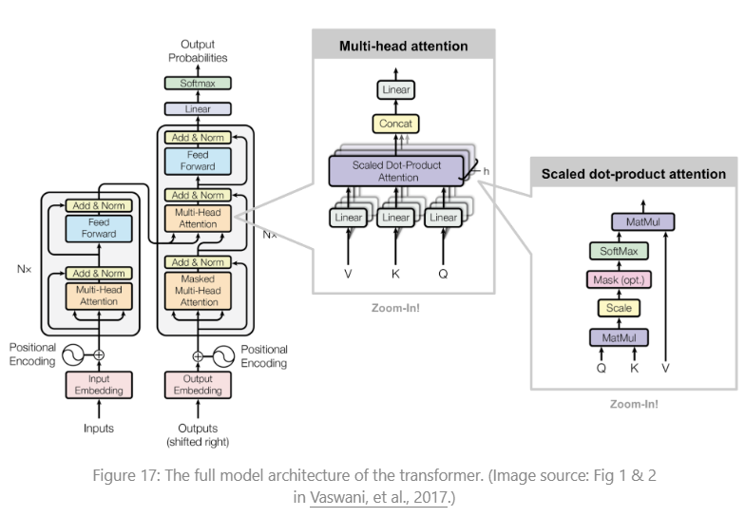

Slide 22
Reference
https://lilianweng.github.io/posts/2018-06-24-attention/
https://jalammar.github.io/illustrated-transformer/

Slide 23
Thank You

